Slide 1
Introduction to DI(IOC)

Slide 2
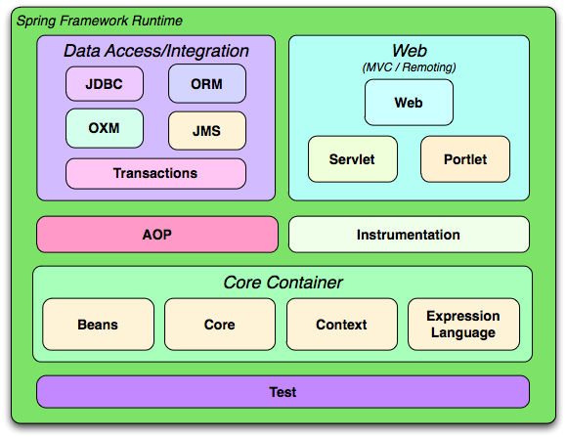
Spring Modules /Architecture

Slide 3
Spring framework architecture
Spring has a layered architecture which consists of various modules.
All the modules are buit on top of the core container and are mostly independent.
This way, the developer is free to use only the modules that are needed for the particular requirements.
The modules in Spring frmework are grouped into Core Container, Data Access/Integration, Web, AOP (Aspect Oriented Programming), Instrumentation, and Test.

Slide 4
CORE CONTAINER
Core and Beans provide the most fundamental part of the framework including IOC continer and Dependency Injection(DI)
Context provides a means to access objects in a framework-style manner. It inherits its features from the Beans module and adds support for internationalization (using, for example, resource bundles), event-propagation and resource-loading,
Expression Language(EL) supports seting and getting property values, property assigment, method invocation, accessing the context of arrays, collections and indexers, logical and arithmetic operators, named variables and retieval of objects by name from Spring’s IoC container

Slide 5
DATA ACCESS/INTEGRATION
JDBC[Java DataBase Connectivity] provides a JDBC abstraction layer
ORM[Object Relational Mapping] is responsible for Database access and related activities. It provides integration layers for popular object-relational mapping APIs, including JDO, Hibernate,any Orm Tools
OXM [Object/XML Mapping] provides an abstraction layer that supports Object/XML mapping implementations for JAXB, Castor, XMLBeans, JiBX and XStream.
JMS [Java Messaging Service] provides features for creating and consuming messages.
Transaction provides support to programmatic and declarative transaction management for classes that implement special interfaces and for all the POJOs (Plain Old Java Objects)

Slide 6
AOP
It is used as a replacement for EJB container and is much simpler than EJBs.
The most important service provided by AOP is declarative transaction management.
The AOP implementation allows the developer to define point-cuts and method interceptors to keep the ‘concerns’ apart.
This clearly enables decoupling the functionality of the code that needs to be separated.

Slide 7
WEB
The WEB module consists of Web, Web-servlet, Web-porlet, Web-struts as sub-modules.
Web provides the basic web-oriented integration features such as multi part file upload functionality , a web-oriented application context and the initialization of the IoC using servlet listeners and.
Web-Servlet contains Spring’s MVC for the web applications. It is a part of Spring’s web application development stack.
Web-Struts helps in integrating a Struts web tier within a Spring application.
Web-Portlet typically mirrors the functionality of the web-servlet module. It provides the MVC implementation for portlet environment.

Slide 8
INSTRUMENTATION n TEST
It provides class instrumentation support and also class loader implementations to be used in a certain application servers.
Supports testing of Components using Junits.

Slide 9
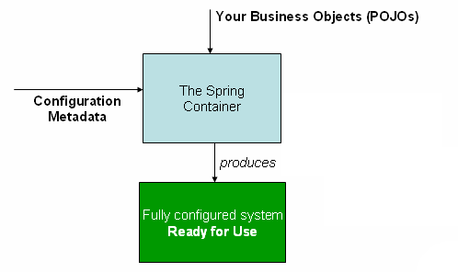
Example

Slide 10
Example
public class TestApp{ public static void main(String[] args) { ApplicationContext context = new ClassPathXmlApplicationContext("Beans.xml"); HelloWorld obj = (HelloWorld)context.getBean(“h"); obj.getMessage(); } }

Slide 11
Application context is created using framework API ClassPathXmlApplicationContext(String ref).
This API loads beans configuration fileâBeans.xml(in our case)which contains details of the beans and the corresponding property values.
Then it takes care of creating and initializing all the objects i.e., beans mentioned in the configuration file
Each <bean ></bean> tags.
The configuration xml file has been loaded. Now, the bean ID is used to obtain a generic object of the required class using getBean() method on the created context. This method returns a generic object which can be finally casted to actual object

Slide 12
File : Beans.xml
Xml components Description
1. Bean Id -A unique Id defined for a particular class object/an aspect. Once this is defined, it can be used to access the corresponding class, just as a className is used 2. Class – Path of the class that is mapped to this particular bean 3. Scope -Defines the bean scope, as in singleton, prototype etc., 4. Property- For one, used to inject values to attribute using setter injection. Name Attribute name , Value value to the attribute that is being injected 5. Constructor-arg Used to inject values to attribute using constructor injection

Slide 13
scopes
Scope | Description
Singleton | Only one instance of the bean will be available per Spring IOC container. By default, a bean has singleton scope.
Prototype | A new bean instance is returned, every time there is a request
Request | Returns a single bean instance per HTTP request
Session | Returns a single bean instance per HTTP session
globalSession | Returns a single bean instance per global HTTP session

Slide 14
Singleton scope
When a bean is a singleton, only one shared instance of the bean will be managed, and all requests for beans with an id or ids matching that bean definition will result in that one specific bean instance being returned by the Spring container.
To put it another way, when you define a bean definition and it is scoped as a singleton, then the Spring IoC container will create exactly one instance of the object defined by that bean definition. This single instance will be stored in a cache of such singleton beans, and all subsequent requests and references for that named bean will result in the cached object being returned.
Defined as:<bean id=“h" class="com.adam.app>helloWorld" singleton =“true“/>
R
:<bean id=“h" class="com.adam.app>helloWorld" />

Slide 15
Prototype scope
This results in creation of a new bean instance everytime a request is made with that particular beanId(say, using getBean(“beanID”) ) . A bean of prototype scope can be defined as
<bean id=“h" class="com.adam.app>helloWorld" singleton="false"/>
R
<bean id=“h" class="com.adam.app>helloWorld" scope="prototype"/>

Slide 16
IOC/DI
One of the core concepts in Spring is Inversion Of Control(IOC). It makes use of BeanFactory to manage Java objects from instantiation to destruction.
The IOC implements Dependency Injection, thereby facilitating loose coupling between components(POJOs). When it comes to large codes, one of the main problems at hand would be the dependencies between the various classes.

Slide 17
POJO Classes
MetaData/Configration file(springBean.xml)
Spring F/m
Ready to use Application

Slide 18
IOC/DI cont..
Typically high level modules depend on low level modules for their values/functionalities. Here, whenever a change is required we have to face the problem of
Rigidity : Changing one part of code might affect other parts of the code
Fragility : One change might lead to unexpected changes from other parts
Immobility : Reuse of the code is impossible because the application is so much tangled already.

Slide 19
IOC/DI cont..
Spring uses Dependency Injection[DI] as a rescue for this problem. The underlying classes are made abstract and the instantiation, management and class casting of the objects are done by the spring framework’s IOC container.

Slide 20
It is clear from the above diagram representation, Spring container acts as a bridge between the abstract POJO classes which contains the blue print of the required model and the metadata which provides data for the POJO classes.
This way, there is no dependency for classes on one another. Making the programming abstract through dependency injection is the solution for handling the above stated problems which are mainly associated with development, enhancement and maintenance of large codes.

Slide 21
Dependency lookup
If resource/application is spending time to search and gather its dependent values then it is called Dependency lookup.
In Dependency lookup the resource/application pulls the values from other resources.
Ex:Student gathers his course material(dependent value ) from institute by requesting(gathering explicitly) for it.

Slide 22
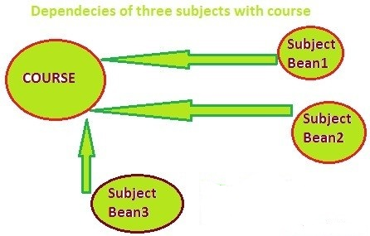
What is dependency injection ?

Slide 23
What is dependency injection ?
dependency injection is a technique whereby one object supplies the dependencies of another object. A "dependency" is an object that can be used
The "injection" refers to the passing of a dependency (a service) into the object
Dependency injection (also called inversion of control) is basically giving an object what it needs instead of letting this object get it by itself.
In Dependency injection container dynamically pushes the dependent value to resource/application.
Ex:Student is getting course material(dependent value ) automatically the moment he registered for Course.

Slide 24
An injection is the passing of a dependency (a service) to a dependent object (a client).
Passing the service to the client, rather than allowing a client to build or find the service, is
the fundamental requirement of the pattern.
“Dependency injection is a pattern where the container passes objects by name to
other objects, via either constructors, properties, or factory methods.”

Slide 25
Dependency injection (DI) is a process whereby objects define their dependencies, that is, the other objects they work with.
The container then injects those dependencies when it creates the bean. This process is fundamentally the inverse, hence the name Inversion of Control (IoC), of the bean itself controlling the instantiation or location of its dependencies on its own.

Slide 26
Advantages of Dependency Injection
Decoupling: Code is cleaner with the DI principle and decoupling is more effective when objects are provided with their dependencies.
Easier to test: As such, your classes become easier to test, in particular when the dependencies are on interfaces or abstract base classes, which allow for stub or mock implementations to be used in unit tests.

Slide 27
IOC
IOC (Inversion of control) is a general parent term while DI (Dependency injection) is a subset of IOC.
IOC is a concept where the flow of application is inverted. So for example rather than the caller calling the method.
SomeObject.Call();
Will get replaced with an event based approach as shown below.
SomeObject.WhenEvent += Call();
The responsibilities of IOC container are:
Instantiating the bean
Wiring the beans together
Configuring the beans
Managing the bean’s entire life-cycle

Slide 28
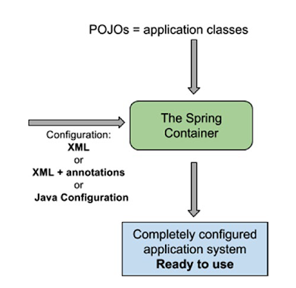

Slide 29
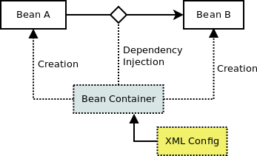
The above digram shows spring container creates two beans from configuration instructions, and injects a dependency between the two beans. In particular, bean A automatically gets a reference to bean B without explicitly asking for it or creating it.

Slide 30
dependency injection
Dependency injection is a software design pattern that implements inversion of control for resolving dependencies.
A dependency is an object that can be used (a service). An injection is the passing of a dependency to a dependent object (a client) that would use it.

Slide 31
Benefits of Dependency Injection
Separation of Concerns
Boilerplate Code reduction in application classes because all work to initialize dependencies is handled by the injector component
Configurable components makes application easily extendable
Unit testing is easy with mock objects

Slide 32
Disadvantages of Dependency Injection
Dependency injection has some disadvantages too:
If overused, it can lead to maintenance issues because effect of changes are known at runtime.
Dependency injection hides the service class dependencies that can lead to runtime errors that would have been caught at compile time.

Slide 33
There are two primary approaches to implementing DI:
constructor injection:
Constructor Injection is the DI technique of passing an object's dependencies to its constructor
bean id=“ref" class=“class Name"> <constructor-arg value=“parameter value" /> </bean>
And setter injection:
Setter Injection does not force dependencies to be passed to the constructor. Instead, the dependencies are set onto public properties exposed by the object in need
<bean id=“ref" class=“class Name">
<property name=“propertyfiledName" value=“value"/> </bean><

Slide 34
Spring java based Annotation
The @Bean annotation is used to indicate that a method instantiates, configures, and initializes a new object to be managed by the Spring IoC container.
@Bean is a method-level annotation and a direct analog of the XML element <bean />
We can use the @Bean annotation in a @Configuration-annotated or in a @Component-annotated class
Annotating a class with @Configuration indicates that its primary purpose is as a source of bean definitions.
Spring Configuration annotation indicates that the class has @Bean definition methods.
So Spring container can process the class and generate Spring Beans(object) to be used in the application.

Slide 35
Spring Bean Scopes
The core of spring framework is it’s bean factory and mechanisms to create and manage such beans inside Spring container. The beans in spring container can be created in five scopes.
singleton
prototype
request
session
global-session

Slide 36
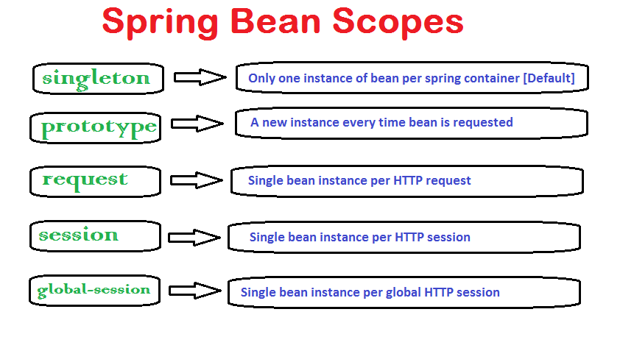

Slide 37
singleton: This bean scope is default and it enforces the container to have only one instance per spring container irrespective of how much time you request for its instance. This singleton behavior is maintained by bean factory itself.
prototype: This bean scope just reverses the behavior of singleton scope and produces a new instance each and every time a bean is requested.
Remaining three bean scopes are web applications related. Essentially these are available through web aware application context (e.g. WebApplicationContext). Global-session is a little different in sense that it is used when application is portlet based. In portlets, there will be many applications inside a big application and a bean with scope of ‘global-session’ will have only one instance for a global user session.

Slide 38
request: With this bean scope, a new bean instance will be created for each web request made by client. As soon as request completes, bean will be out of scope and garbage collected.
session: Just like request scope, this ensures one instance of bean per user session. As soon as user ends its session, bean is out of scope.
global-session:

Slide 39
How to define the bean scope
1) In bean configuration file
<beans xmlns="http://www.springframework.org/schema/beans"
xmlns:xsi="http://www.w3.org/2001/XMLSchema-instance"
xsi:schemaLocation="http://www.springframework.org/schema/beans
http://www.springframework.org/schema/beans/spring-beans-2.5.xsd">
<bean id="demoBean" class="com.howtodoinjava.application.web.DemoBean" scope="session" />
</beans>

Slide 40
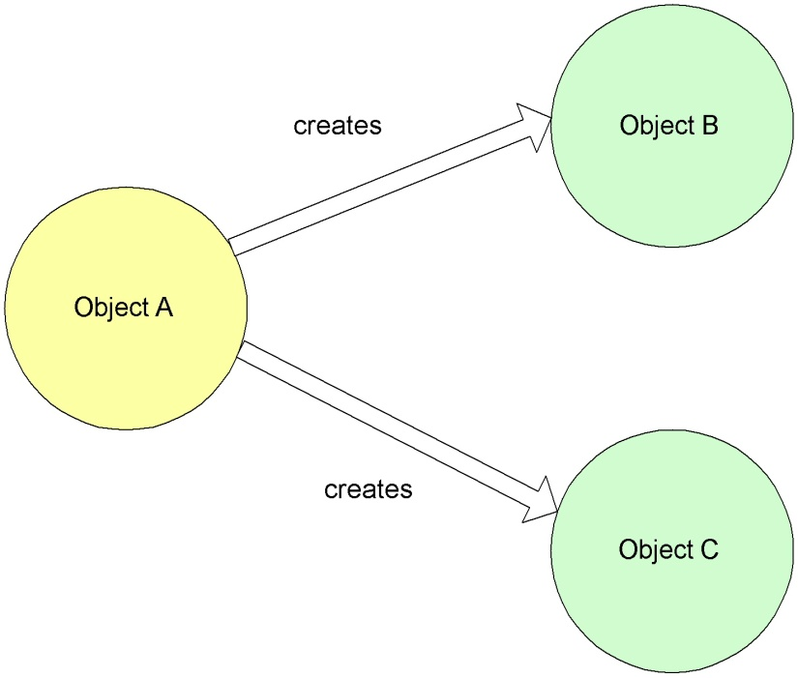
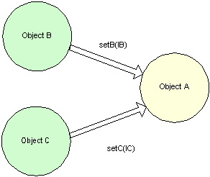
Non-IoC versus IoC
Non Inversion of Control approach
Inversion of Control approach

Slide 41
DI/IOC/Bean wiring
DI is process where container is resonsible to create the bean instances and alsoresonsible to associate the dependencies.
The main advantage of DI s loose coupling.
Using DI we can Inject the following types of values:
1)primitives:
<property name="id“value="1"></property>
2)String:<property name=“name“value=“Adam"></property>

Slide 42
DI/IOC/Bean wiring
List:using <list> tag in our configuration file
<property name=“listofcar" >
<list>
<value>bmw</value>
<value>zen</value>
<value>audi a6</value>
<value>polo</value>
</list>
</property>
Set: List:using <set> tag in our configuration file
<property name=“listofcar" >
<set>
<value>bmw</value>
<value>zen</value>
<value>audi a6</value>
<value>polo</value>
</set>
</property>

Slide 43
DI/IOC/Bean wiring
Map:Map uses key, value pair to store the values. A pair of key and value is called as a entry. We will be using <entry> tag in our configuration file
<property name=“listofcar" >
<map>
<entry key="bmw"> <value>black</value> </entry> <entry key="zen"> <value>black</value> </entry>
<entry key=" audi a6 "> <value>red</value></entry>
</map>
</property>

Slide 44
DI/IOC/Bean wiring
Properties:
Like Map we have key and values associated to the Property as well. We will be using<props> tag in our configuration file to inject values.
<property name="props">
<props>
<prop key="admin">admin@gmail.com</prop>
<prop key="manager">manager@gmail.com</prop>
</props>
</property>.
User Defined DataTypes

Slide 45
Diff b/w setter and constructor InJ…
setter | constructor
In Setter Injection, partial injection of dependencies can possible, means if we have 3 dependencies like int, string, long, then its not necessary to inject all values if we use setter injection. If you are not inject it will takes default values for those primitives | In constructor injection, partial injection of dependencies cannot possible, because for calling constructor we must pass all the arguments right, if not so we may get error
Setter injection makes bean class object as mutable [We can change ] | Constructor injection makes bean class object as immutable [We cannot change ]
It is optional | It is mandatory

Slide 46
Implict autowiring
The major drawback of explict autowirung is the bean wiring has to be done explicitly by the developer and requires too much of xml configuration.
If we use implict autowiring the bean wiring be taken care impliclty by spring conatiner.
Implict autowiring can be done two ways.
1)using xml(autowire attribute of <bean> tag)
2)using annotations (using @Autowired spring annotation)

Slide 47
autowiring
Auto-wiring is feature given by spring framework which is use to
manage the dependency automatically.
Spring IoC container is able to find dependency and manage
dependency implicitly.
By default Auto-Wiring is disable in spring framework.
If we want to enable Auto-Wiring to manage dependency automatically t
hen we have to use autowire attribute in spring XML configuration file.

Slide 48
autowiring
We can enable auto-wire spring IoC container in four ways.
byName
byType
Constructor
Autodetect.
autodetect has been removed in spring 3.0 onward.

Slide 49
Implict autowiring cont..
Spring Aut-Wiring byName
If we will enable Auto Wiring by using byName then Spring IoC Container will find dependency by using property name in target class.
If property name of dependent class and bean id must be same then only Spring IoC Container will manage dependency automatically.

Slide 50
Implict autowiring cont..
Spring autowire using byType
In case of spring auto wiring by using byType spring IoC Container will search class type of the attribute.
In this case class type of the attribute and given class name in bean configuration must be same other wise it will be initialized with null value.

Slide 51
Implict autowiring cont..
Spring Auto-Wire Constructor
if we will enable auto-wiring by using constructor attribute then spring IoC Container will try to find a bean whose class type is same as constructor parameter type if a matching constructor found in target class then IOC will inject other it we will get exception.

Slide 52
Spring @Autowired Annotation
Spring @Autowired Annotation is use to manage the dependency automatic.
If we annotated any dependent class by using @Autowired annotation then Spring IoC container is able to find dependency and manage dependency implicitly.
We can manage dependency in spring framework by using autowire attribute in spring XML configuration file using ref attribute or by using @Autowired annotation.

Slide 53
Spring @Autowired Annotation
@Autowired :
The basic idea of using annotations is to avoid too much coding of complicated XML.
we need to enable annotation based configuraiton in spring bean configuration file using below tag
< context:annotation-config/>

Slide 54
@Qualifier annotation in spring
@Qualifier annotation in spring is use to resolve the spring bean ambiguity problem.
When two or more than two similar beans having same class are declared in bean configuration.
If two similar beans having same class are declared in bean configuration file then Spring IoC Container will not able to understand which bean should autowired and Spring IoC Container will ends up with some exception org.springframework.beans.factory.BeanCreationException with message No unique bean of type.

Slide 55
@Required
if we want to mandate some fields to be mandatory to be injected then we have to use @Required annotation with setter method.
@Scope annotation in spring
@Scope annotation in spring is use to change the scope of bean life cycle within the Spring IoC Container as we know by default Scope of bean is singleton but if want to change the scope of bean then we can use @Scope annotation in spring Framework.

Slide 56
Stereotype Annotations in Spring
Stereotype Annotations Cut Down XML Configuration in Spring.
In Spring 2.0 introduce the first StereotypeAnnotations name as @Repository. The @Component Annotation introduced in Spring 2.5 .
If we want to enable StereotypeAnnotations
We need declare <context:component-scan base-package=“packagename" />is in the Spring XML configuration(spring.xml).

Slide 57
<context:annotation-config> is used to activate annotations in beans already registered in the application context (no matter if they were defined with XML or by package scanning).
<context:component-scan> can also do what <context:annotation-config> does but <context:component-scan> also scans packages to find and register beans within the application context.

Slide 58
The Four Types :
@Component generic stereotype for any Spring-managed component
@Repository stereotype for persistence layer
@Service stereotype for service layer
@Controller| stereotype for presentation layer (spring-mvc)

Slide 59
@Component is a generic stereotype for any Spring-managed component.
Example:
@Component
public class Employee{
private Address address;
}

Slide 60
@Repository: @Repository annotation is a marker for any class that fulfills the role or stereotype (also known as Data Access Object or DAO) of a repository.
All your database access logic should be in DAOclasses.
Ex:
@Repository
public class EmployeeDaoImpl implements EmployeeDao {
//database logic like jdbc r hibernate r any orm tool
}

Slide 61
@Service: Annotate all your service classes with @Service. All your business logic should be in Service classes.
@Service
public class EmployeeServiceImpl implements EmployeeService {
// business logic r servicelogic
}.
@Controller:
The @Controller annotation indicates that a particular class serves the role of a controller.
Spring does not require you to extend any controller base class or reference the Servlet API.
@Controller
public class EmployeeController {
//controller logic
}

Slide 62
Spring allows you to do two things:
1)Autowiring of beans
2)Autodiscovery of beans
1. Autowiring Usually in springfile.xml you define beans and other beans are wired using constructor or setter methods.
You can wire beans using XML or annotations.
In case you use annotations, you need to activate annotations and you have to add <context:annotation-config /> in springfile.xml.
This will simplify the structure of the tag from applicationContext.xml, because you will not have to manually wire beans (constructor or setter). You can use @Autowire annotation and the beans will be wired by type.

Slide 63
2. Autodiscovery Autodiscovery is simplifying the XML one step further, in the sense that you don't even need too add the <bean> tag in springfile.xml.
You just mark the specific beans with one of the following annotation and Spring will automatically wire the marked beans and their dependencies into the Spring container. The annotations are as follow: @Controller, @Service,@Component, @Repository.
By using <context:component-scan> and pointing the base package, Spring will auto-discover and wire the components into Spring container.

Slide 64
Spring DAO Module:
The Spring JDBC Template has the following advantages compared with standard JDBC.
The Spring JDBC template allows to clean-up the resources automatically, e.g. release the database connections.
The Spring JDBC template converts the standard JDBC SQLExceptions into RuntimeExceptions. This allows the programmer to react more flexible to the errors. The Spring JDBC template converts also the vendor specific error messages into better understandable error messages.

Slide 65
The JdbcTemplate class is the central class in the JDBC core package. It simplifies the use of JDBC since it handles the creation and release of resources.
This class executes SQL queries, update statements or stored procedure calls, imitating iteration over ResultSets and extraction of returned parameter values.

Slide 66
Spring obtains a connection to the database through a DataSource. A DataSource(I) is part of the JDBC specification and is a generalized connection factory.
It allows a container or a framework to hide connection pooling and transaction management issues from the application code.
As a developer, you need not know details about how to connect to the database; that is the responsibility of the administrator that sets up the datasource.and wire the components into Spring container.
DataSource Implimentation classes:
1)From Spring .DriverManagerDataSource
<bean id="dataSource" class="org.springframework.jdbc.datasource.DriverManagerDataSource">
<property name="driverClassName" value="com.mysql.jdbc.Driver" />
<property name="url" value="jdbc:mysql://localhost:3306/TestDB" />
<property name="username" value="pankaj" />
<property name="password" value="pankaj123" />
</bean>

Slide 67
From Tomcat:DBCP
<bean id="dataSource" class="org.apache.commons.dbcp.BasicDataSource"">
<property name="driverClassName" value="com.mysql.jdbc.Driver" />
<property name="url" value="jdbc:mysql://127.0.250.1:3306/omg" />
<property name="username" value="adminFu9C5ne" />
<property name="password" value="cQwukjVQExGI" />
</bean>.
From C3P0 configuration:
<bean id="dataSource" class="com.mchange.v2.c3p0.ComboPooledDataSource"
destroy-method="close" scope="prototype">
<property name="driverClass" value="org.postgresql.Driver" />
<property name="url" value="jdbc:mysql://127.0.250.1:3306/omg" />
<property name="username" value="adminFu9C5ne" />
<property name="password" value="cQwukjVQExGI" />
</bean>

Slide 68
Spring MVC
The Spring web MVC framework provides model-view-controller architecture and ready components that can be used to develop flexible and loosely coupled web applications.
1.The Model encapsulates the application data and in general they will consist of POJO.
2.The View is responsible for rendering the model data and in general it generates HTML output that the client's browser can interpret.
spring also supports other view technologies such as Apache Velocity, Thymeleaf and FreeMarker.
3.The Controller is responsible for processing user requests and building appropriate model and passes it to the view for rendering. the @Controller annotation is used to mark the class as the controller.

Slide 69
Spring MVC
Front Controller - In Spring Web MVC, the DispatcherServlet class works as the front controller. It is responsible to manage the flow of the Spring MVC application.

Slide 70
Advantages of Spring MVC
Supports RESTful URLs.
Annotation based configuration.
Supports to plug with other MVC frameworks like Struts etc.
Separate roles - The Spring MVC separates each role, where the model object, controller, view resolver, DispatcherServlet, validator, etc. can be fulfilled by a specialized object.
Light-weight - It uses light-weight servlet container to develop and deploy your application.

Slide 71
MVC – An overview
Model
Controller
Request
View
Response

Slide 72
DispatcherServlet- Responsiblities
Initialize the framework to cater to the requests.
Load the map of all the URLs and the components responsible to handle the request.
Prepare the map for the views.

Slide 73
Spring 3 MVC- Basic Architecture
HandlerMapping
(Map of URL and controllers)
2
DispactherServlet
(Front controller)
Controller
(Responsible to handle request)
Request
3
1
4
Model
(POJO)
5
View (JSP, XML, Velocity)

Slide 74
HandlerMapping
2
3
1
Controller
Dispatcher-Servlet
ModelAndView
4
5
6
View
ViewReslover

Slide 75
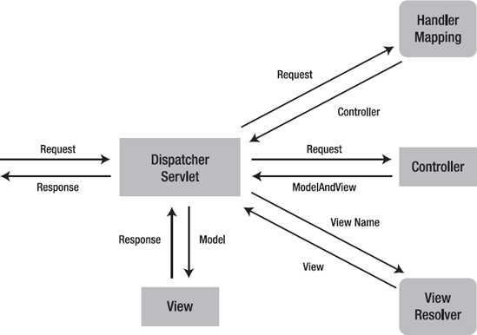

Slide 76
Following is the Request process lifecycle of Spring MVC:
1)The client sends a request to web container in the form of http request.
2)This incoming request is intercepted by Front controller(DispatcherServlet) and it will then tries to find out appropriate Handler Mappings.
3)With the help of Handler Mappings, the DispatcherServlet will dispatch the request to appropriate Controller.
4)The Controller tries to process the request and returns the Model and View object in form of ModelAndView instance to the Front Controller.
5)The Front Controller then tries to resolve the View (which can be JSP, Freemarker, Velocity etc) by consulting the View Resolver object.
6)The selected view is then rendered back to client.

Slide 77
Important Components
DispatcherServlet
Controller
HandlerMapping/@RequestMapping
ModelAndView
@ModelAttribute
ViewResolver

Slide 78
DispatcherServlet
The Dispatcher Servlet follows the Front Controller Design Pattern for handling Client Requests.
It means that whatever Url comes from the Client, this Servlet will intercept the Client Request before passing the Request Object to the Controller.

Slide 79
DispatcherServlet
The DispatcherServlet is an actual Servlet (it inherits from the HttpServlet base class), and as such is declared in the web.xml of web application.
we need to map requests that you want the DispatcherServlet to handle, by using a URL mapping in the same web.xml file.

Slide 80
DispatcherServlet
It is the heart of the Spring Web MVC framework; this core component receives all requests to your application.
It map a request to a class or method that should handle it (implementations of the HandlerMapping interface).
handle a request using a specific pattern, like a regular servlet.
It resolve views by name, allowing you to use different templating engines,XML, XSLT or any other view technology (implementations of the ViewResolver interface)

Slide 81
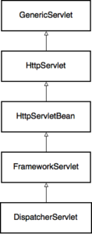
Processing of an HTTP Request

Slide 82
Controller
Controllers are components that are being called by the Dispatcher Servlet for doing any kind of Business Logic
Spring Distribution already comes with a variety of Controller Components each doing a specific purpose - spring 2.x
SimpleFormController
AbstractController
MultiActionController
Spring 3 Controller
@Controller Annotation

Slide 83
Controller
@Controller
public class HelloWorldController {
@RequestMapping("/hello")
public ModelAndView helloWorld() {
String msg = "HELLO Don HOW R U";
return new ModelAndView("hellopage", "message", msg);
}
}

Slide 84
HandlerMapping
A Handler Mapping provides an abstract way that tell how the Client's Url has to be mapped to the Handlers.
Four concrete variation of Handler Mapping are available
BeanNameUrl HandlerMapping
CommonsPathMap HandlerMapping
ControllerClassName HandlerMapping
SimpleUrl HandlerMapping

Slide 85
ModelAndView
ModelAndView is a holder of two distinct objects:
Model – a key-value map of data used to render the page
View – a template of the page that is filled with data from the model
ModelandView is returned by the Controller object back to the Dispatcher Servlet.
ModelAndView(viewName, “Key”, object);
return new ModelAndView("demosp", "message", msg);

Slide 86
Controller
Spring MVC 3.0
1)The @Controller annotation marks this class as Controller.
2)The @Requestmapping annotation is used to map the class with the specified name.
3) class returns the instance of ModelAndView controller with the mapped name, message name and message value. The message value will be displayed in the jsp page.

Slide 87
In this xml file, we are specifying the servlet class DispatcherServlet that acts as the front controller in Spring Web MVC. All the incoming request for the html file will be forwarded to the DispatcherServlet
<web-app> <servlet>
<servlet-name>spring</servlet-name>
<servlet-class>
org.springframework.web.servlet.DispatcherServlet</servlet-class>
<load-on-startup>1</load-on-startup>
</servlet>
<servlet-mapping>
<servlet-name>spring</servlet-name>
<url-pattern>*.html</url-pattern>
</servlet-mapping>
</web-app>
Spring MVC looks for a file named [servlet-name]-servlet.xml in the WEB-INF directory of your web application and creates the beans defined there.

Slide 88
View Resolver
The mapping between the Logical name and the Physical View Location is taken care by the View Resolver object.
Spring comes with a set of Built-In Spring Resolvers.
We can write Custom View Resolvers by implementing the org.springframework.web.servlet.ViewResolver interface

Slide 89
Define the bean in the xml file:filename should servletName-servlet.xml. The location of bean file should in side WEB-INF
return new ModelAndView("hellopage", "message", msg);
The above hellopage is jsp page,Controller search for hellopage inside
WEB-INF/jsp folder.
<beans XSd>
<context:component-scan base-package="com.adam.app" />
<bean class="org.springframework.web.servlet.view.InternalResourceViewResolver">
<property name="prefix" value="/WEB-INF/jsp/" />
<property name="suffix" value=".jsp" />
</bean>
</beans>
Note:the prefix + the logical View Name + the suffix.
Inside hellopage.jsp write below statement(message is key which controller returned to jsp page
Message is: ${message}

Slide 90
Controller without MAV
@Controller
public class DemoSpring3Controller {
@RequestMapping(value="demoSpring3")
public String helloWorld(@MA Pojo/String/Dto,MM m) {
String msg = "Hello";
return “success”;
}

Slide 91
View Resolver
Password Encoding is the process in which a password is converted from a literal text format into a humanly unreadable sequence of characters.
There are many ways to encode a password - encryption, hashing, salting, slow hashing

Slide 92
View Resolver
InternalResourceViewResolver Controller returns - new ModelAndView("myView1") or
Return “success”
<bean id="viewResolver“ class="org.springframework.web.servlet.view.InternalResourceViewResolver">
<property name="prefix“ value=“/”>
</property>
<property name="suffix“ value=“.jsp”>
</property>
</bean>
the prefix + the logical View Name + the suffix
/WEB-Contatent/myView.jsp

Slide 93
Spring 3.0 MVC Configuration
Step 2:
Configure the contextConfigLocation for the application context to be loaded
<context-param>
<param-name>contextConfigLocation</param-name>
<param-value>/WEB-INF/spring3-service.xml</param-value>
</context-param>
<listener>
<listener-class>
org.springframework.web.context.ContextLoaderListener
</listener-class>
</listener>

